Slide 1
Lecture 1(A)
E- Learning

Slide 2
Definition
E-learning is commonly referred to the intentional use of networked information and communications technology in teaching and learning.
As the letter “e” in e-learning stands for the word “electronic”, e-learning would incorporate all educational activities that are carried out by individuals or groups working online or offline, and synchronously or asynchronously via networked or standalone computers and other electronic devices.

Slide 3
Types
Self paced e-learning online
Self paced e-learning offline
Group based e-learning synchronously
Group-based e-learning asynchronously

Slide 4
Self paced e-learning online
individualized self-paced e-learning online refers to situations where an individual learner is accessing learning resources such as a database or course content online via an Intranet or the Internet. A typical example of this is a learner studying alone or conducting some research on the Internet or a local network.

Slide 5
self-paced e-learning offline
Individualized self-paced e-learning offline refers to situations where an individual learner is using learning resources such as a database or a computer-assisted learning package offline (i.e., while not connected to an Intranet or the Internet). An example of this is a learner working alone off a hard drive, a CD or DVD.

Slide 6
Group-based e-learning synchronously
Group-based e-learning synchronously refers to situations where groups of learners are working together in real time via an Intranet or the Internet. It may include text-based conferencing, and one or two-way audio and videoconferencing. Examples of this include learners engaged in a real-time chat or an audio-videoconference

Slide 7
Group-based e-learning asynchronously
Group-based e-learning asynchronously refers to situations where groups of learners are working over an Intranet or the Internet where exchanges among participants occur with a time delay (i.e., not in real time). Typical examples of this kind of activity include on-line discussions via electronic mailing lists and text-based conferencing within learning managements systems.

Slide 8
Tutorial 1
Bangladesh open university broadcasts educational program in TV. But the problem is that students can not communicate with the teachers while watching TV. Suggest any group based learning solution for the students so that can enable the communication between teacher and student.
Design a mobile app for that system.

Slide 9
Learning Management System
Moodle
Google Classroom
Blackboard
Sakai
Latitude Learning
Schoology
Canvas
Source: http://blog.capterra.com/top-8-freeopen-source-lmss/

Slide 10

Free Books
Website: www.bookzz.org

Slide 11
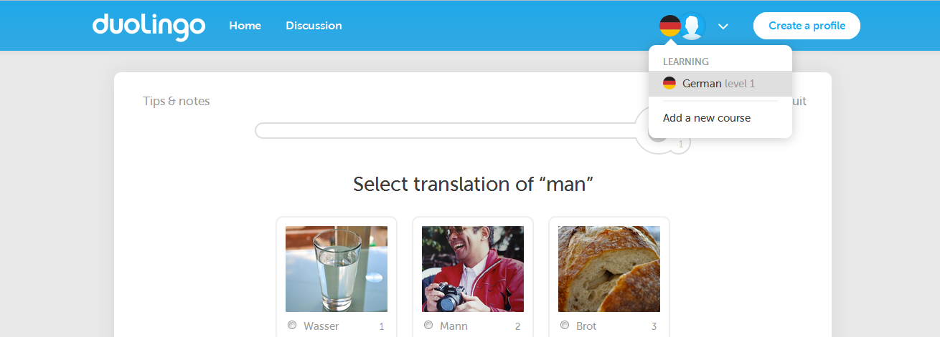
Language Learning Tool
https://www.duolingo.com/

Slide 12
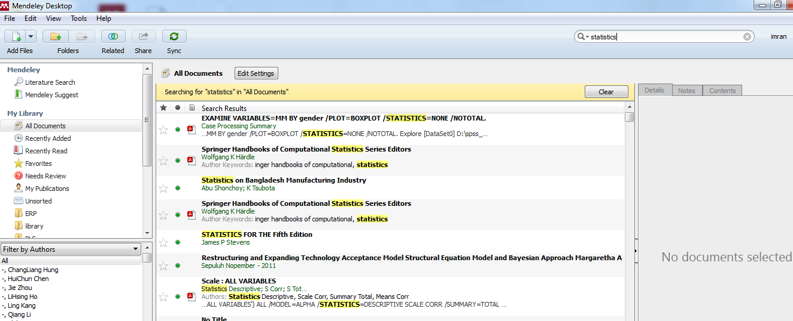
Mendeley (PDF search)

Slide 13
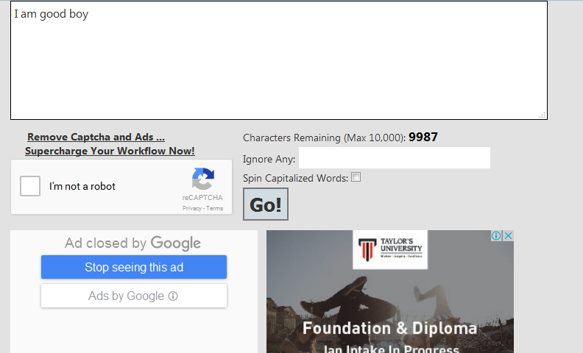

Word spinning software
https://spinbot.com/

Slide 14
Storage
Dropbox
Google drive
Skydrive
Degoo (100GB)
iDrive
JustCloud.com
Livedrive
Source: http://cloudnewsdaily.com/cloud-storage/

Slide 15
Words
Digital Storytelling [need to check]
Flipped Classroom
Gamification
MOOC- Massive Open Online Course

Slide 16
Lecture 1(B)
Book

Slide 17
A digital firm is one in which nearly all of the organization’s significant business relationships with customers, suppliers, and employees are digitally enabled and mediated.
Business processes refer to the set of logically related tasks and behaviors that organizations develop over time to produce specific business results and the unique manner in which these activities are organized and coordinated.

Slide 18
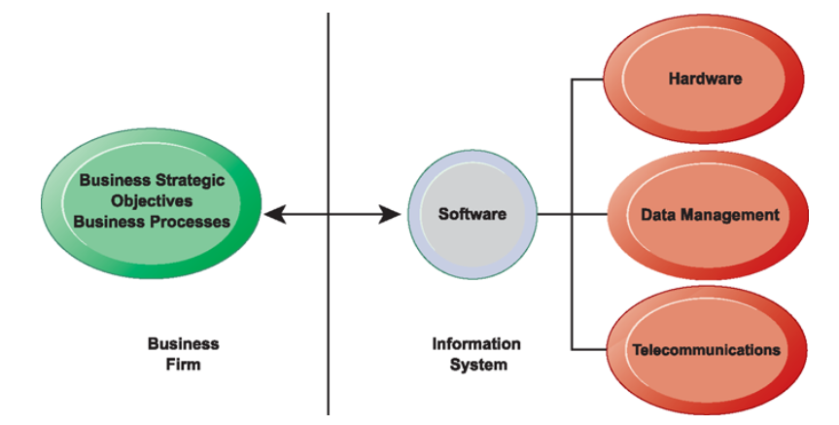
THE INTERDEPENDENCE BETWEEN ORGANIZATIONS AND INFORMATION SYSTEMS

Slide 19
A business model describes how a company produces, delivers, and sells a product or service to create wealth.
Information technology (IT) consists of all the hardware and software that a firm needs to use in order to achieve its business objectives.
An information system can be defined technically as a set of interrelated components that collect (or retrieve), process, store, and distribute information to support decision making and control in an organization.

Slide 20
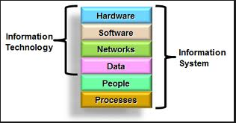
IT vs IS

Slide 21
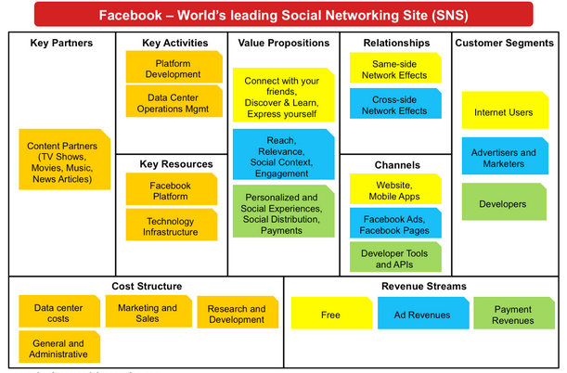
Business Model

Slide 22
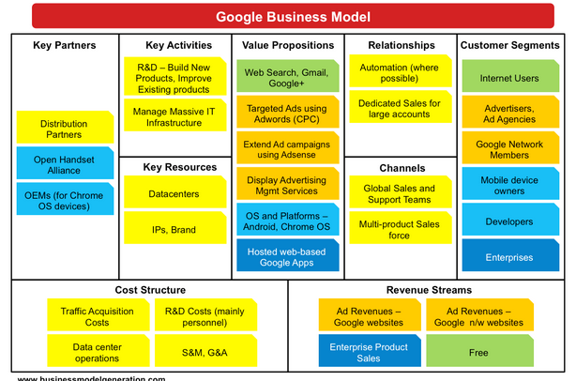

Slide 23
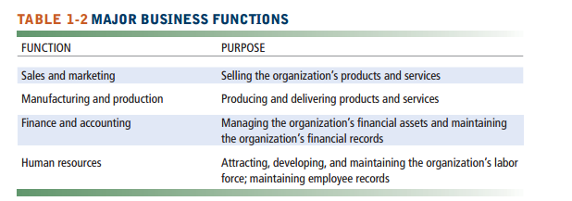
Business Functions

Slide 24
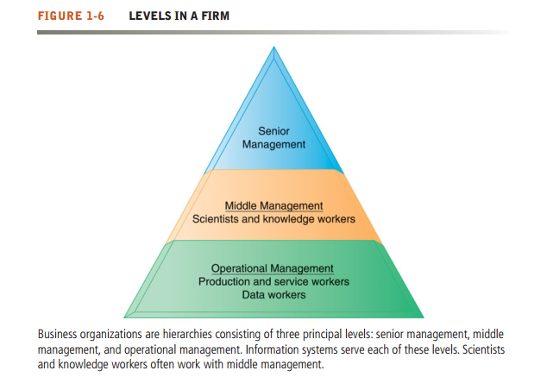

Slide 25
Levels in organization
Senior management makes long-range strategic decisions about products and services as well as ensures financial performance of the firm. Middle management carries out the programs and plans of senior management and operational management is responsible for monitoring the daily activities of the business. Knowledge workers, such as engineers, scientists, or architects, design products or services and create new knowledge for the firm, whereas data workers, such as secretaries or clerks, assist with scheduling and communications at all levels of the firm. Production or service workers actually produce the product and deliver the service

Slide 26
organizational and management capital
Research on business information technology investment indicates that firms that support their technology investments with investments in complementary assets, such as new business models, new business processes, management behavior, organizational culture, or training,

Slide 27
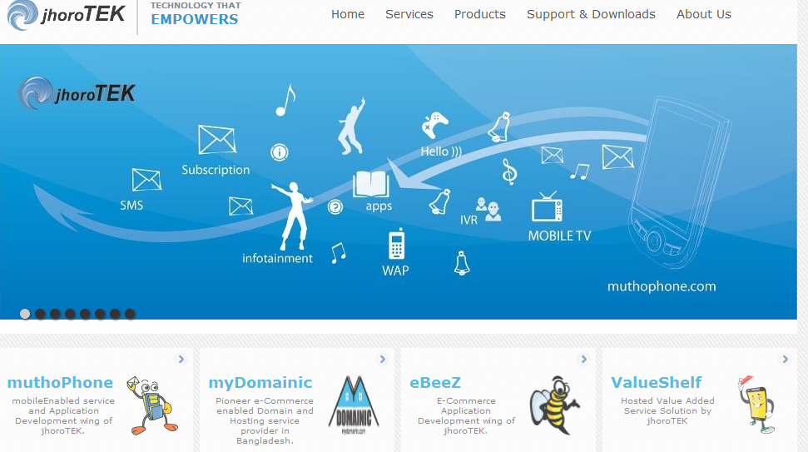
Tutorial 2

Slide 28
Tool
https://canvanizer.com/new/business-model-canvas
https://creately.com/app/?tempID=gc7qvpsj1&login_type=demo
https://www.lucidchart.com/users/login#?demo=on

Slide 29
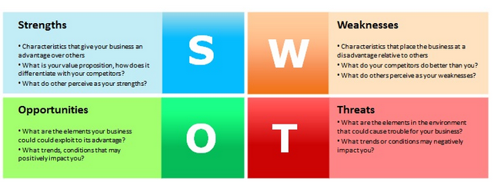

Slide 30
